Slide 1
Ch6 Software Architectures Design
Software System Design and Architecture
Ding Er-Yu
Software Institute, Nanjing University

Slide 2
Main Contents
An Introduction to Architecture Design
A Simple Example
Software Architecture Design
Strategies and tactics

Slide 3
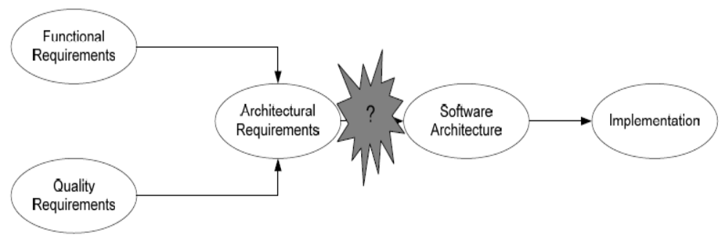
Architectural Design

Slide 4
Purposes of Architecture Analysis&Design
To transform requirements into design of system
To evolve robust architecture for system
To adapt design to match implementation environment

Slide 5
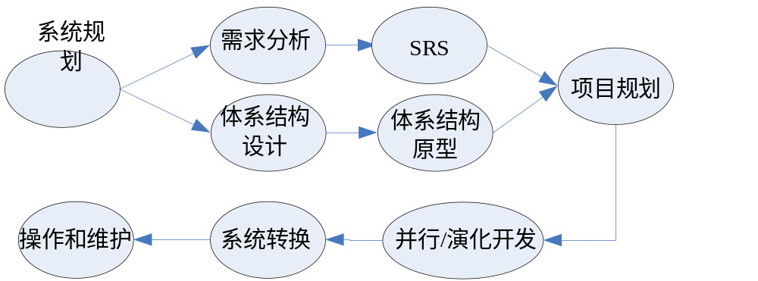
Software processes with Architectural Design

Slide 6
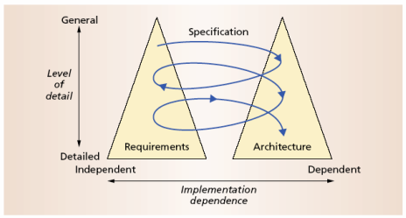
The Twin Peaks Model

Slide 7
Architecture Design Methods
The Unified Software Development Process, G. Booch, J. Rumbaugh & I, Jacobson.
A System of Patterns: Pattern-Oriented Software Architecture, F. Buschman et al.
Object-Oriented Modeling and Design, J. Rumbaugh
Design and use of software architectures, J. Bosch.
Software Architecture in Practice, P. Clements, L. Bass & R. Kazman
Applied Software Architecture, C. Hofmeister et al.
Software Product Lines, P. Clements & L. Northrop
Software Architectures: Perspectives on an Emerging Discipline, M. Shaw
Synthesis-Based Software Architecture Design, Tekinerdogan & Aksit
…

Slide 8
Essentials in SA design
Structures
  High-level Structure
  Multi-view: 4+1
Concerns
  Qualities and Environments
    Analysis requirements
    Finding factors
Design decision
  Giving solution to factors
  Documenting design rational
Styles
  A group of design decisions

Slide 9
Main Contents
An Introduction to Architecture Design
A Simple Example
Software Architecture Design
Strategies and tactics

Slide 10
有一个软件开发企业想在其局域网内建立一个资源管理系统，现状如下：
  公司每天都要做大量的代码处理工作：简单的语言互转（例如将Java转换为C++，或者反之），各种语言程序的自动集成与测试，对不同语言进行切片等程序分析，进行编码的转换（Unicode转换为GBK）……
  为了更好地完成上述工作，该公司购买了很多工具软件。但是因为工具软件的注册数量限制，而且一台机器也无法提供足够的资源同时支持很多工具软件，所以各工具软件被分散地安装在整个局域网内，形成了可以利用的分散资源。这种分散使得各种资源的寻找和利用都面临着很大的问题，效率低下

Slide 11
为了解决工具软件在局域网内比较分散以致不利于充分利用的问题，该公司计划开发一个资源管理系统：
  在局域网的每一个机器上都安装客户端：
    用户可以通过客户端向服务器申请获得特定类型的资源；
    用户可以通过客户端向资源的管理机器请求使用获得的资源。
  局域网内有多台服务器：
    服务器维护资源的分布及使用情况；
    服务器可以为提出申请的用户分配相应的资源；
    为了防止服务器故障导致系统崩溃，提高系统的可靠性，需要使用多台并发服务器；

Slide 12
为了解决工具软件在局域网内比较分散以致不利于充分利用的问题，该公司计划开发一个资源管理系统：
  安装有工具软件资源的机器需要进行本地资源的管理：
    系统要定期复查拥有资源机器的加入与退出情况；
    定期向服务器通报最新的资源使用及空闲情况；
    提供统一的资源管理接口，方便客户端对资源的远程使用；
    要易于接受新的资源类型，具有好的可扩展性。

Slide 13
Main Contents
An Introduction to Architecture Design
A Simple Example
Software Architecture Design
  体系结构分析
  定义初始体系结构
  体系结构的建立
Strategies and tactics

Slide 14

Use-Case Driven Software Architecture Design
C. Hofmeister
  <Applied Software Architecture>/<实用软件体系结构>， 2000
  Global Analysis: Moving from Software Requirements Specification to Structural Views of the Software Architecture, 2005.

Slide 15
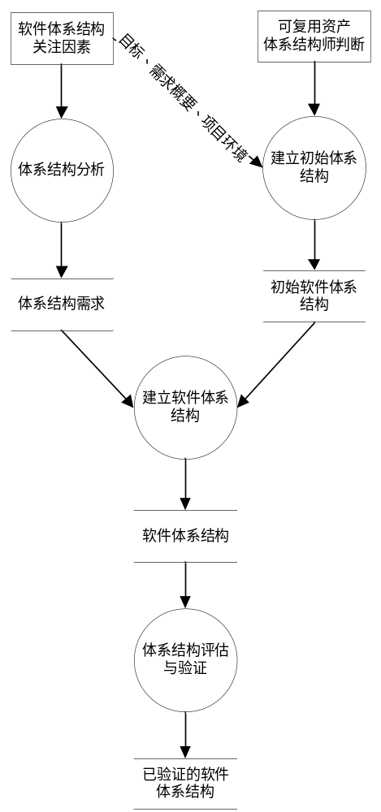

Slide 16
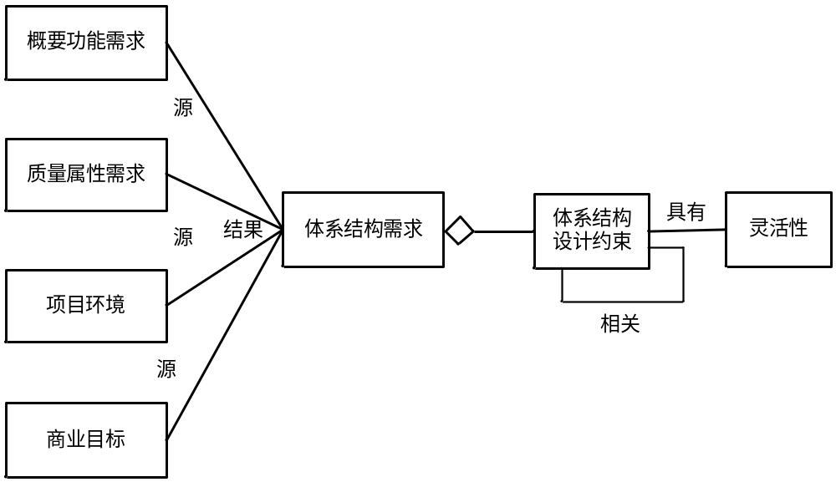
体系结构分析

Slide 17
类别 | 影响因素 | 描述
开发环境 | 人员能力 | 员工所熟悉开发方法的限制；特殊技能员工的缺乏；员工整体能力的限制
 | 组织与管理 | 开发过程的要求；开发工具的要求；成本与利益考虑
 | 资源 | 特殊资源的缺乏；开发工具的缺乏；员工人数的限制
商业环境 | 市场 | 上市时间；上市进度安排；市场广度；预期市场持续时间
技术环境 | 软件环境 | 操作系统；网络系统；数据库系统；需要交互的软件；其他特殊软件
 | 硬件环境 | 处理机能力；存储能力；网络硬件环境；特殊硬件
 | 支撑技术 | 中间件平台；开发框架；程序语言；特殊开发技术
 | 标准 | 通信标准；特殊技术标准
典型项目环境影响因素列表

Slide 18
资源管理系统的主要关注点列表
关注点 | 类型 | 描述 | 灵活性
可修 改性 | 质量属性 | 资源类型可能会发生变化； | 灵活性不大，资源类型肯定会发生变化
可靠性 | 质量属性 | 要避免因为服务器故障导致系统崩溃 | 如果故障后能够在3小时内恢复，那么每周1次的故障频率可以接受
时间 效率 | 质量属性 | 要尽快获知系统内各客户端的启动、关闭与资源使用、分布情况，保证资源利用的有效性 | 从10秒到5分钟，都是较好的时间效率。5～10分钟也可以勉强接受
网络 环境 | 开发环境 | 系统功能要在网络环境下部署，这会限制程序调用机制的使用 | 如果利用远程过程调用RPC，可以在网络环境中实现程序调用效果 有些网络交互利用网络通信方式解决
人员技能 | 开发环境 | 熟悉复杂网络交互开发技术的人员欠缺 | 灵活性不大，企业不会专门雇佣新的人员
团队 组织 | 开发环境 | 系统开发工作应该尽快完成 | 即使没有资源管理系统，人们也可以继续用过去的方式工作

Slide 19
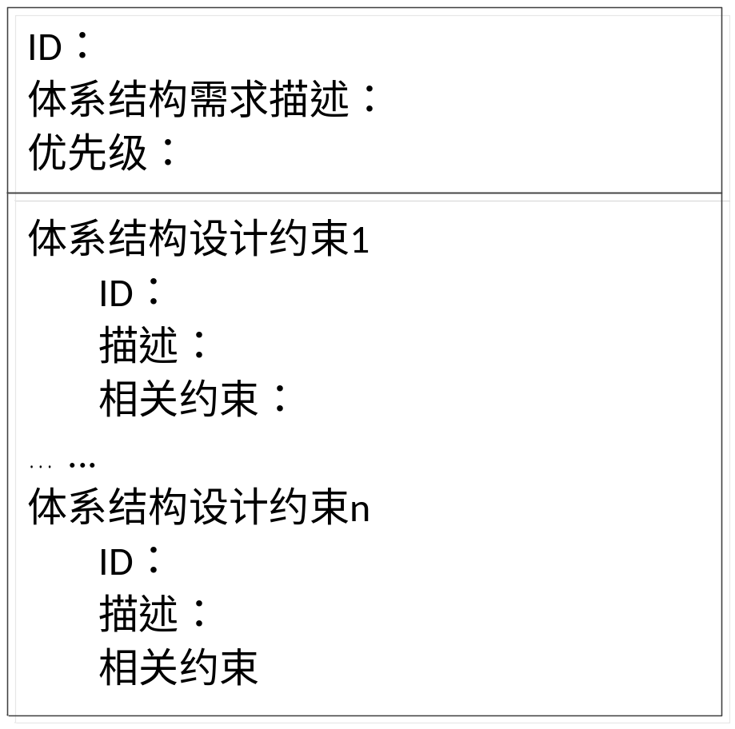
体系结构分析：定义体系结构需求
软件体系结构需求不同于软件需求
  有一部分软件体系结构需求来源于软件需求
  有些软件体系结构需求来自于软件需求之外的因素
涉及功能需求的部分只要求粗略的要求
对于质量属性和项目环境部分，则需要进行明确的定义
体系结构设计约束是指：软件体系结构设计方案在解决关注点问题时必须要满足的限制条件

Slide 20
体系结构需求 | 设计约束 | 相关约束
R1 实现资源的可扩展性 | C1 增加一种新资源类型的代价低于0.25人月
R2 保证服务器运行的可靠性 | C2 服务器可靠性>=55/56 | C3 促进 C2
 | C3 服务器故障应该在10分钟内侦测
R3 服务器要实时更新资源分布与使用情况 | C4 服务器与客户端的通信间隔<=5m
R4设计方案允许快速开发 | C5 开发时间<=2月 | C8 促进 C5
R5 有效解决网络交互 | C5 开发时间<=2月
 | C6 网络间的同步交互使用RPC机制 | C6 阻碍 C8
 | C7 网络间的异步交互使用简单通信机制
 | C8 开发中不涉及复杂的网络交互功能

Slide 21
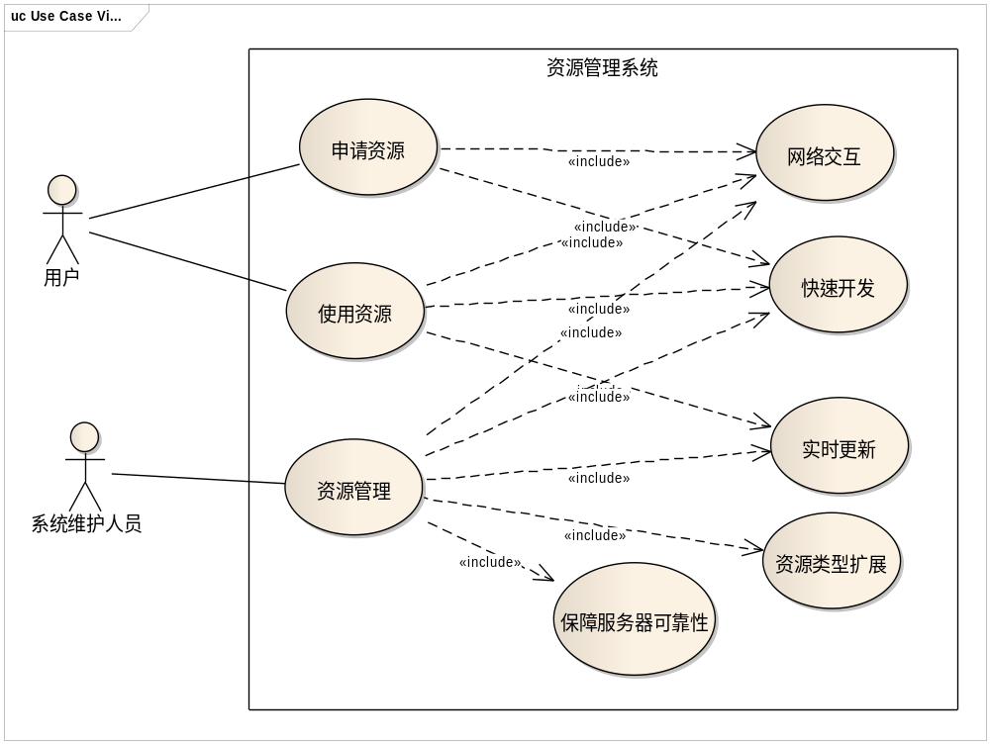

Slide 22
定义软件体系结构需求的场景描述
Use Cases View of “4+1” VIEW
一般场景（General Scenario）方法。
一般场景方法的提出是为了给质量属性需求定义可验证的场景描述，它可以被扩展用于定义所有软件体系结构需求的场景描述。

Slide 23
一般场景方法
一般场景方法为每个体系结构需求-设计约束定义如下事项：
  刺激：一旦发生就需要系统给出应对的现象。例如，运行时的故障、开发时的需求变更等。
  刺激源：产生刺激的实体，可能是用户，也可能是计算系统。
  环境：刺激发生时的情况。例如系统正常还是异常。
  制品：被刺激影响到的制品，例如部件、子系统或者模块等。
  响应：接受到刺激后采取的行动，例如处理一个事件或者实现一个变更。
  响应的度量：响应必须要满足的约束，例如响应行为必须在10秒内完成。

Slide 24
项目 |  | 内容
场景ID |  | S1
商业目标 |  | 扩大资源管理的范围
相关需求与设计约束 |  | R1 实现资源的可扩展性 | C1 增加一种新资源类型的代价低于0.25人月
场景内容 | 刺激 | 新的资源类型
 | 刺激源 | 用户
 | 环境 | 正常使用时
 | 制品 | 资源管理子系统
 | 响应 | 扩展资源管理子系统，使得系统能管理新的资源类型
 | 响应的度量 | 扩展时间<=0.25人月

Slide 25
Main Contents
An Introduction to Architecture Design
An Simple Example
Software Architecture Design
  体系结构分析
  定义初始体系结构
  体系结构的建立
Strategies and tactics

Slide 26
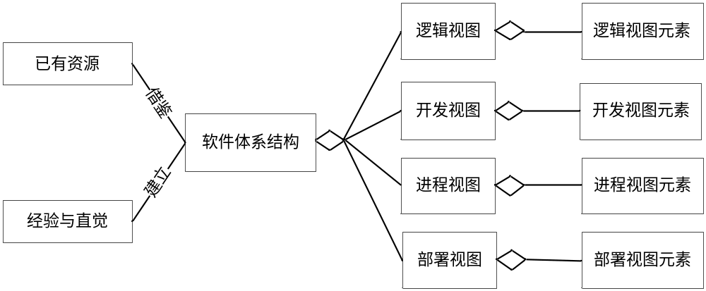
定义初始体系结构

Slide 27
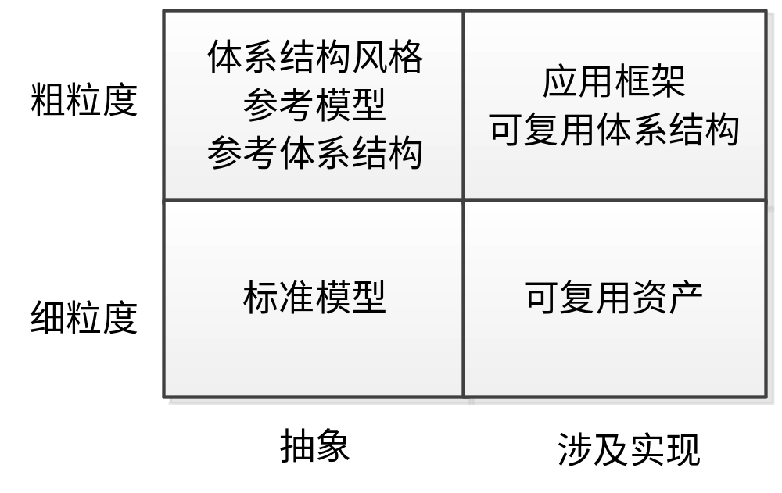
利用已有资源建立初始软件体系结构

Slide 28
从空白开始建立初始软件体系结构
利用模块化、信息隐藏等基本的设计原则分析和处理概要功能需求，建立能够反映功能需求概要的体系结构雏形。
根据体系结构关注点，依据经验与直觉，使用相关的设计策略，修改上一步的体系结构雏形，建立初始软件体系结构。

Slide 29
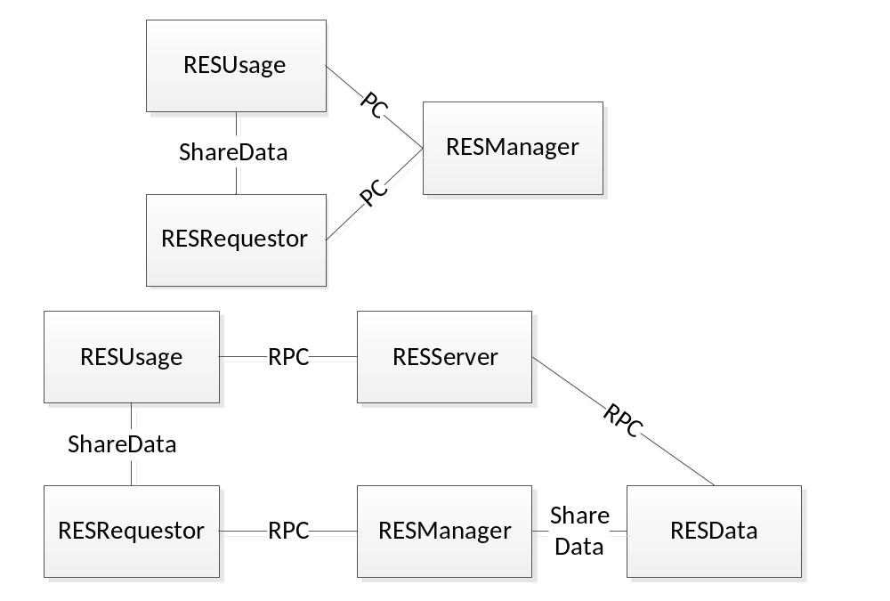
资源管理系统的初始体系结构

Slide 30
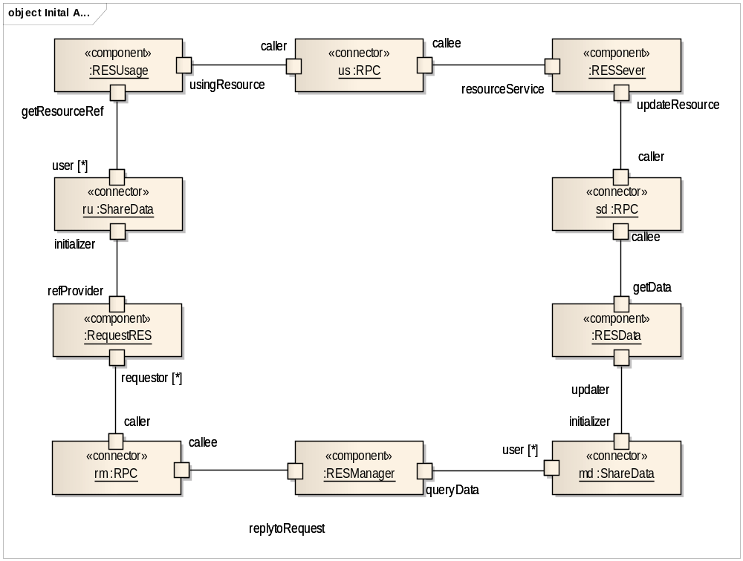
初始软件体系结构的表示
逻辑视图配置描述

Slide 31
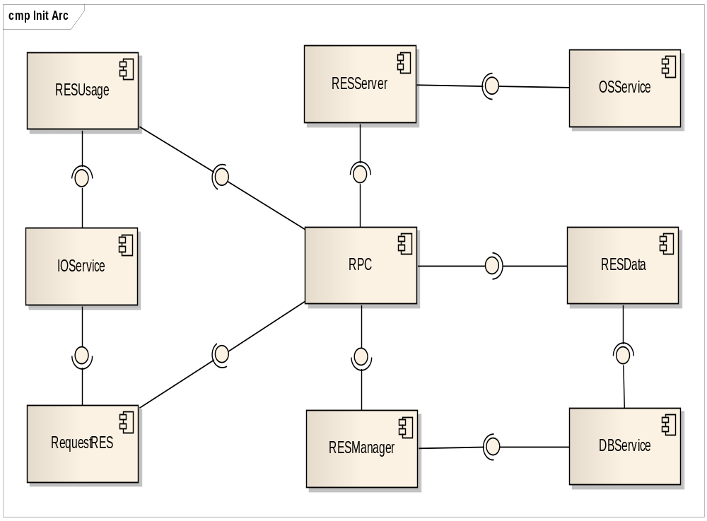
初始软件体系结构的表示
资源管理系统初始体系结构开发视图的模块组织

Slide 32
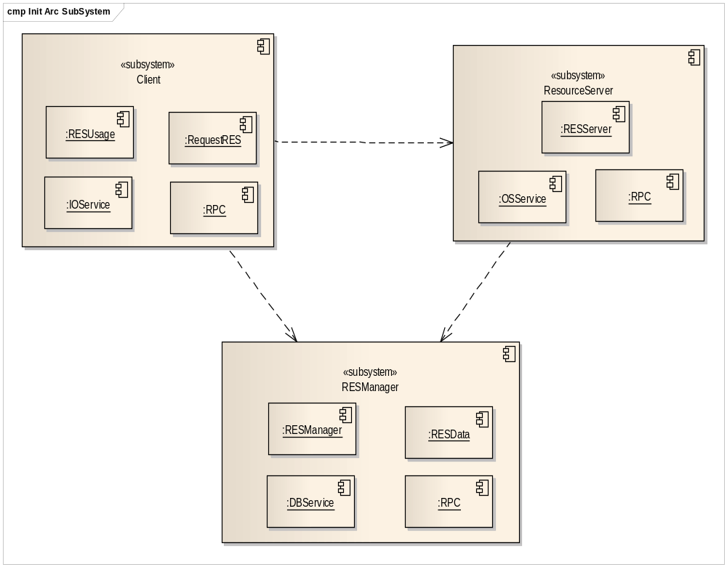
初始软件体系结构的表示
资源管理系统初始体系结构开发视图的子系统组织

Slide 33
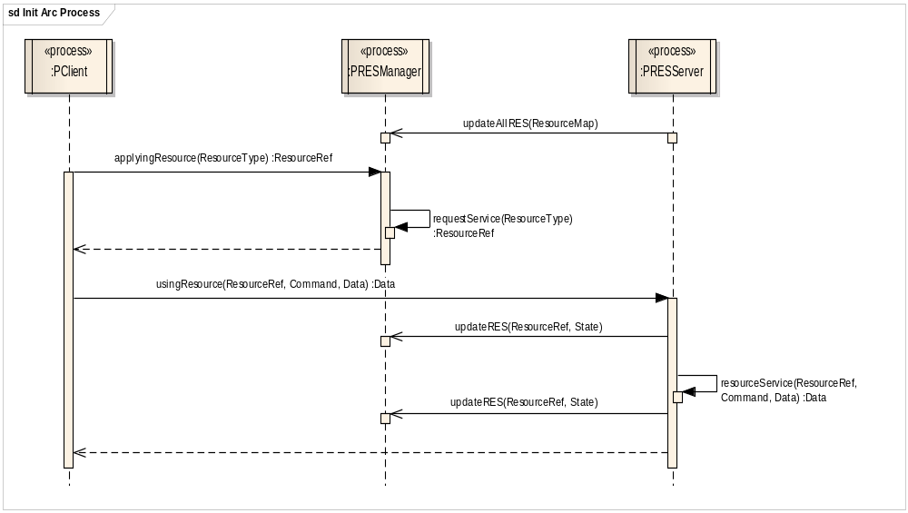
初始软件体系结构的表示
资源管理系统初始体系结构进程视图的进程协作描述

Slide 34
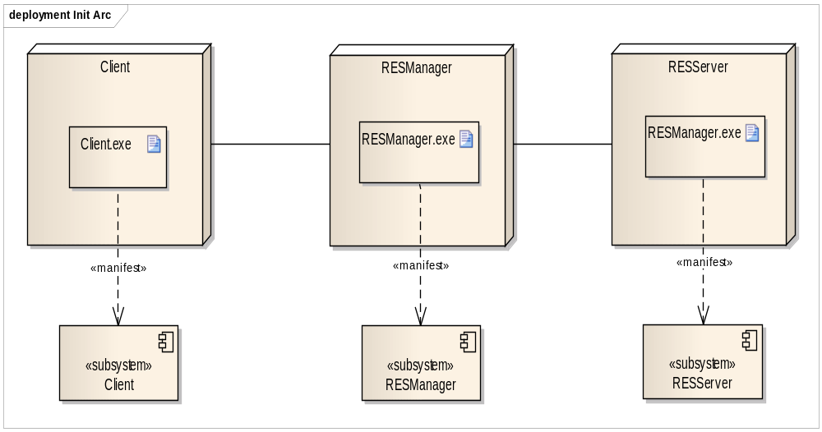
初始软件体系结构的表示
资源管理系统初始体系结构部署视图的部署描述

Slide 35
Main Contents
An Introduction to Architecture Design
An Simple Example
Software Architecture Design
  体系结构分析
  定义初始体系结构
  体系结构的建立
Strategies and tactics

Slide 36
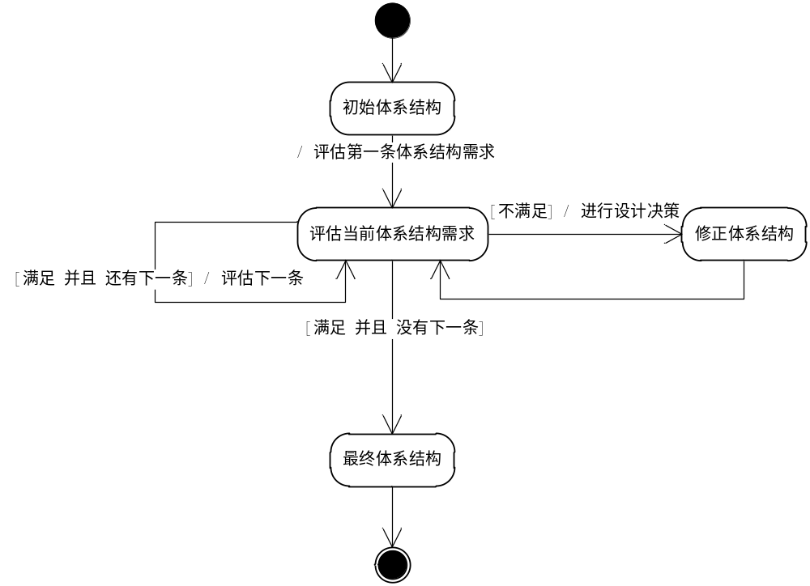
建立体系结构的演化过程

Slide 37
Assessing Quality Attributes
3 assessment techniques
  Simulation
    abstract simulated context
    evaluation through scenario execution
    Correctness, performance, reliability & robustness
  mathematical modeling/metrics
  experience-based reasoning

Slide 38
Assessing Quality Attributes
3 assessment techniques
  Mathematical Modeling
    static analysis by calculation
    performance modeling, real-time task models
  Experience-based Reasoning
    especially for experienced software engineers
    basis for other techniques

Slide 39
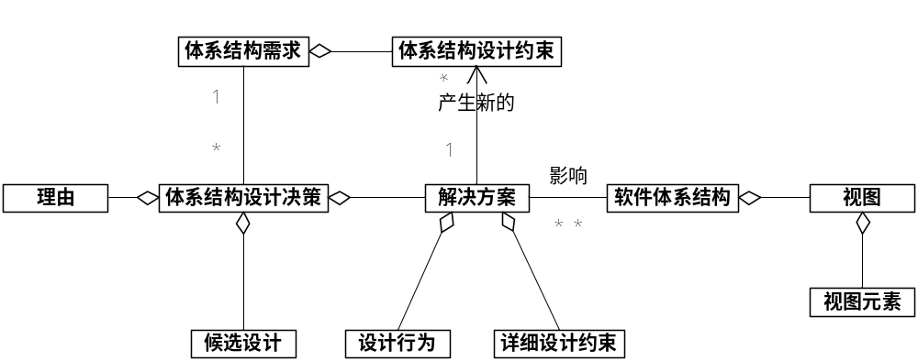
设计决策

Slide 40
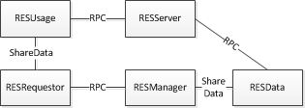
设计决策过程（1）
R1 实现资源的可扩展性
  C1 增加一种新资源类型的代价低于0.25人月
  封装资源
  影响：逻辑视图；开发视图
  详细设计约束：隐藏资源信息
VirtualRES

Slide 41
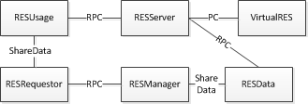
设计决策过程（2）
R2 保证服务器运行的可靠性
  C2 服务器可靠性>=55/56
  C3 服务器故障应该在10分钟内侦测
  使用冗余服务器提高可靠性
  影响：逻辑视图；开发视图；进程视图；部署视图
  新的体系结构约束CA1：一致性更新与Cluster访问
DRPC
CRPC
N

Slide 42

设计决策过程（3）
R2 保证服务器运行的可靠性
  C2 服务器可靠性>=55/56
  C3 服务器故障应该在10分钟内侦测
  使用Ping/Echo方法检测服务器故障
  影响：所有4个视图
  详细设计约束：Ping/Echo规则
Monitor

Slide 43
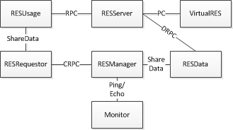
设计决策过程（4）
R3 服务器要实时更新资源分布与使用情况
  C4 服务器与客户端的通信间隔<=5m
  设置RESServer与RESData的通信间隔
  详细设计约束：通信规则

Slide 44
设计决策过程（5）
R4设计方案允许快速开发
  C5 开发时间<=2月
  使用分层式结构，方便并行开发
  影响：开发视图

Slide 45
设计决策过程（6）
R5 有效解决网络交互
  C5 开发时间<=2月
  C6 网络间的同步交互使用RPC机制
  C7 网络间的异步交互使用简单通信机制
  C8 开发中不涉及复杂的网络交互功能
  使用中间件平台作为支撑，便利RPC机制开发
  影响：开发视图；进程视图
  详细设计约束：中间件平台接口；进程的方法调用接口

Slide 46
设计决策过程（7）
R2 保证服务器运行的可靠性
  CA1一致性更新与Cluster访问
  利用中间件平台简化一致性更新与Cluster访问
  影响：开发视图
  详细设计约束：封装一致性规则与Cluster规则

Slide 47
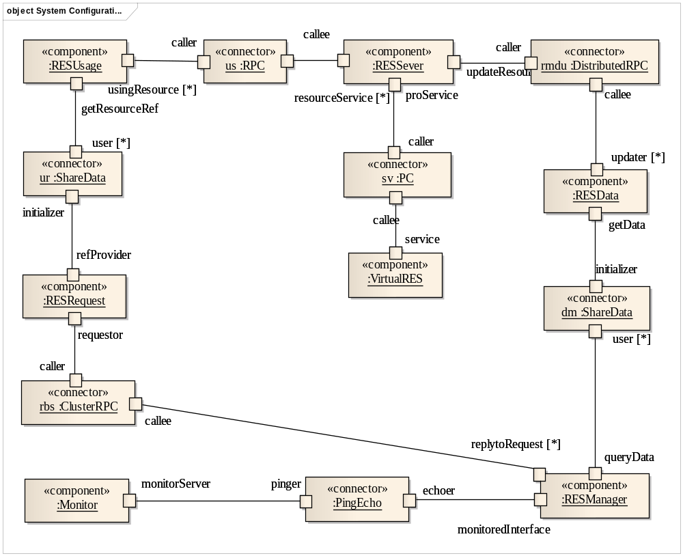
逻辑视图

Slide 48
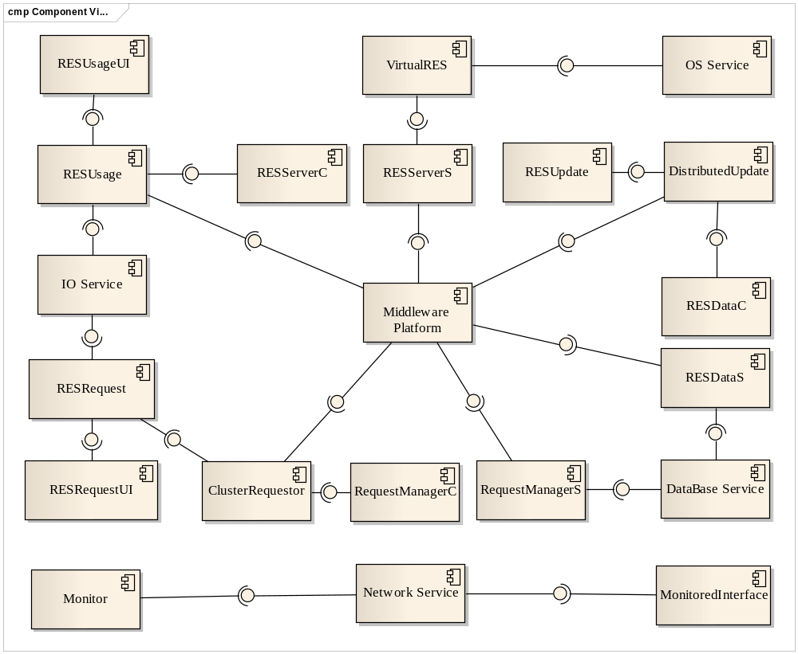
开发视图

Slide 49
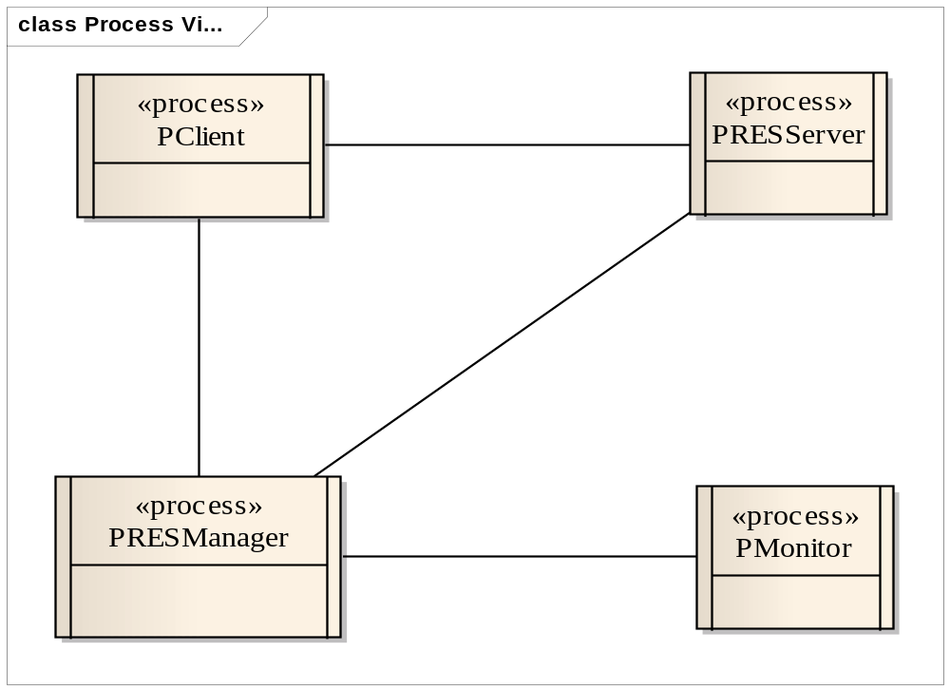
进程视图

Slide 50
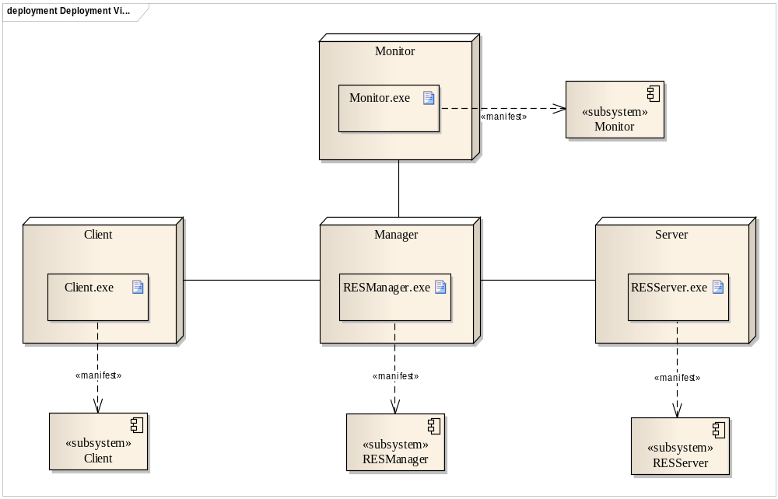
部署视图

Slide 51
Main Contents
An Introduction to Architecture Design
A Simple Example
Software Architecture Design
Strategies and tactics

Slide 52
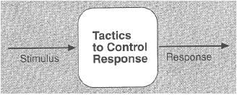
Tactics
design decisions that affect quality attributes
affecting quality attributes means controlling the responses to stimuli
tactics are sometimes related
tactics often affect more than one quality attribute

Slide 53
Tactics
With categories of tactics
Classified according to (main) quality attribute concern
  – Availability
  – Modifiability
  – Performance
  – Security
  – Testability

Slide 54
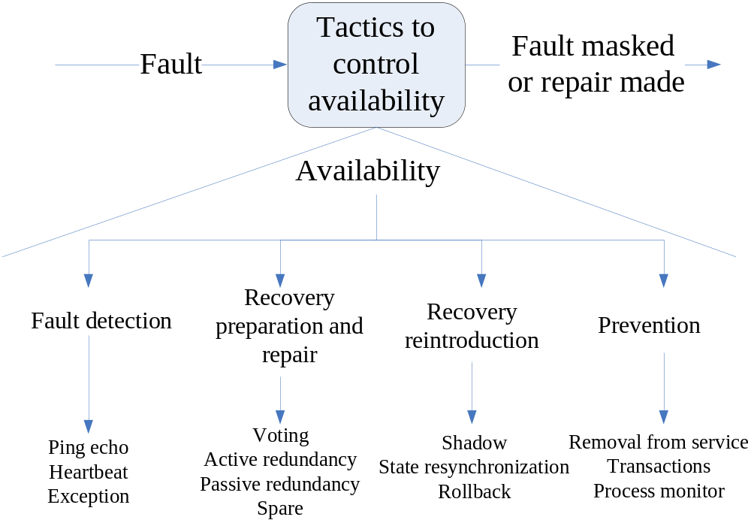
Availability Tactics

Slide 55
Availability Tactics
Fault detection
  Ping/echo
    One component issues a ping and expects to receive back an echo, within a predefined time, from the component under scrutiny
    New Component: Monitor
    (Server) New Port: Monitored
    New Connector: Ping/Echo

Slide 56
Availability Tactics
Fault detection
  Heartbeat (dead man timer)
    One component emits heartbeat message periodically
    Other components listen for it
    The heartbeat can also carry data
    New Component/port: Monitor
    New Component/Port: Broadcaster
    New Connector: Heartbeat

Slide 57
Availability Tactics
Fault detection
  Exceptions
    Raise exception when fault class is encountered
    Operates within a single process.
    The exception handler will usually perform a semantic transformation of the fault into a form that can be processed.
    New Component: Exception Handler
    Connector: Procedural Call

Slide 58
Availability Tactics (3)
Recovery preparation and repair
  Voting
    Processes running on redundant processors each take equivalent input and compute a simple output value that is sent to a voter.
    If the voter detects deviant behavior from a single processor, it fails it.
    The voting algorithm can be "majority rules" or "preferred component" or some other algorithm.
    Modify Connector: PC→Distributed PC
    New Connector(/Component): Voting
    More Component: copy

Slide 59
Availability Tactics (3)
Recovery preparation and repair
  Active redundancy (hot restart)
    Redundant components respond to events in parallel.
    The response from only one component is used, and the rest are discarded.
    When a fault occurs, the downtime of systems using this tactic is usually milliseconds since the backup is current and the only time to recover is the switching time.
    Modify Connector: PC→Active Red PC
    More Component: copy

Slide 60
Availability Tactics (4)
Recovery preparation and repair
  Passive redundancy (warm restart/dual redundancy/triple redundancy )
    One component (the primary) responds to events and informs the other components (the standbys) of state updates they must make.
    When a fault occurs, the system must first ensure that the backup state is sufficiently fresh before resuming services
    More Component
    Modify component/ port
    New connector: State resynchronization

Slide 61
Availability Tactics (4)
Recovery preparation and repair
  Spare
    A standby spare computing platform is configured to replace many different failed components.
    It must be rebooted to the appropriate software configuration and have its state initialized when a failure occurs
    Modify component: More data copy

Slide 62
Availability Tactics (5)
Recovery reintroduction
  Shadow operation
    A previously failed component may be run in "shadow mode" for a short time to make sure that it mimics the behavior of the working components before restoring it to service.
    Modify connector: .. →Shadow ..

Slide 63
Availability Tactics (5)
Recovery reintroduction
  State resynchronization
    Redundancy requires restoring after downtime
    New component State resynchronization or Passive redundancy needed
  Checkpoint/rollback
    Create checkpoint recording consistent state at points in time
    Rollback to previous checkpoint if inconsistent state detected
    New component Checkpoing/rollback or Passive redundancy needed

Slide 64
Availability Tactics (5)
Fault prevention
  Removal from service
    (Periodically) remove component to prevent anticipated failure
    Modify connector:..→Removal ..
  Transactions
    Bundling sequential steps
    Undo all if necessary
    Modify connector: ..→Transaction ..
    New Component：Transaction Manager

Slide 65
Availability Tactics (5)
Fault prevention
  Process monitor.
    Once a fault in a process has been detected, a monitoring process can delete the nonperforming process and create a new instance of it,
    New Component: Monitor
    New Connector: PC

Slide 66
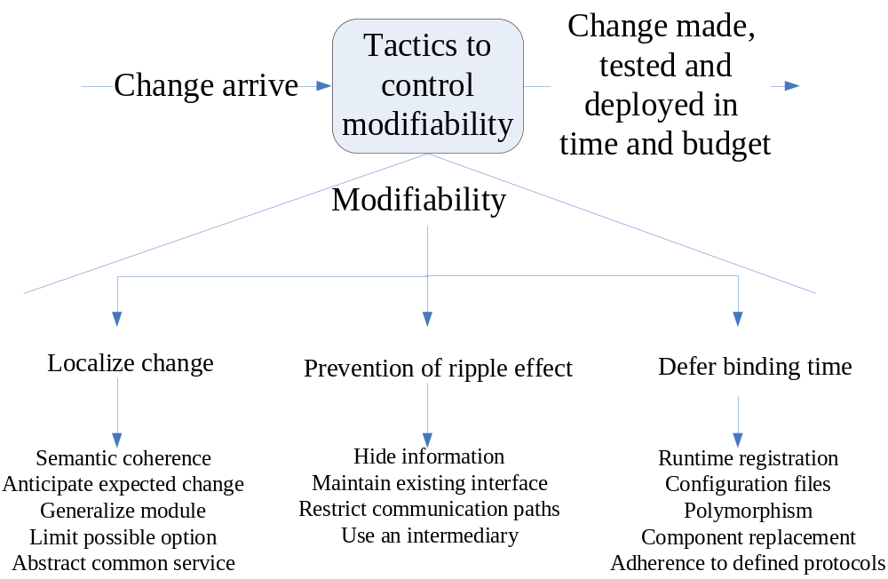
Modifiability Tactics

Slide 67
Modifiability Tactics (2)
Localize changes
  Maintain semantic coherence
    Ensure that all of these responsibilities work together without excessive reliance on other modules
    Comes from choosing responsibilities that have semantic coherence
    Modify Component/connector
  Anticipate expected changes
    Make decomposition so that considered changes affect minimal number of modules
    Based on assumptions of what changes will be

Slide 68
Strategies of Anticipate expected changes
Separate configure data
Separate hardware-specific component
Separate time-critical component
Separate domain model from interfaces
Separate domain model from technologies
Separate monitor from function
Separate error resume from core logic
Separate external interface adapter
New Component/connector

Slide 69
Modifiability Tactics (3)
Localize changes
  Generalize module
    Making a module more general allows it to compute a broader range of functions based on input
      E.g., constants -> input parameters
    The more general a module, the more likely that requested changes can be made by adjusting the input language rather than by modifying the module
    Modify Component/connector
  Limit possible options
    Modifications may be far ranging and hence affect many modules
    Restricting the possible options will reduce the effect of these modifications
    Modify connector/component

Slide 70
Modifiability Tactics (4)
Prevention of ripple effect
  Hide information
    Decompose responsibilities
    Choose which to make public, hide others
    Modify connector/component
  Maintain existing interface
    Mask variations
      adding interfaces, adding adapter, providing a stub
    new connector

Slide 71
Modifiability Tactics (4)
Prevention of ripple effect
  Restricts communication paths
    Restrict the number of module with which a component shares data
    Modify connector/ component
  Use an intermediary
    Create module handling dependencies between components (e.g., Adapter)
    New connector

Slide 72
Modifiability Tactics (5)
Defer binding time
  Runtime registration
    supports plug-and-play operation at the cost of additional overhead to manage the registration
      Publish/subscribe registration, for example
    Modify connector/ component-port
  Configuration files
    set parameters at startup
    Modify component

Slide 73
Modifiability Tactics (5)
Defer binding time
  Polymorphism
    allows late binding of method calls
    Modify connector
  Component replacement
    load time binding
    Modify connector/ component port
  Adherence to defined protocols
    runtime binding of independent processes
    Modify connector/ component port

Slide 74
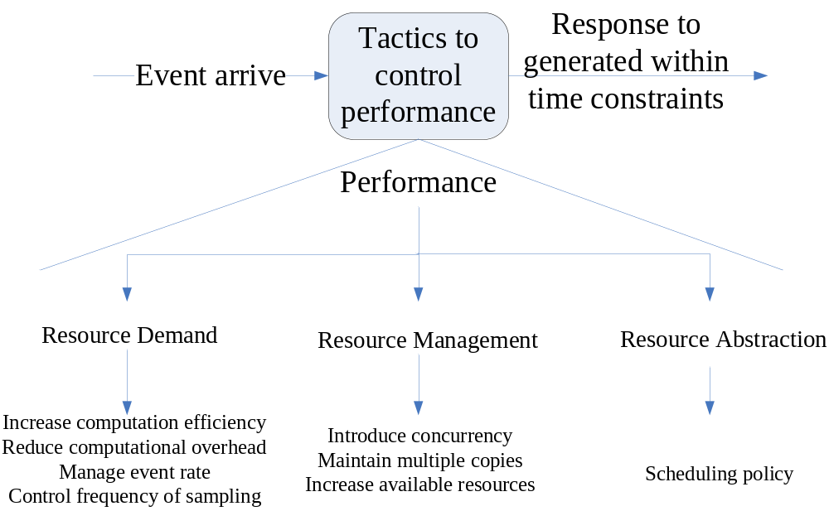
Performance Tactics

Slide 75
Performance Tactics (2)
Resource Demand
  Increase computational efficiency
    Improving the algorithms used in critical areas will decrease latency.
    Sometimes one resource can be traded for another
    Modify(new) component/connector
  Reduce computational overhead
    If there is no request for a resource, processing needs are reduced
    Modify connector/ component

Slide 76
Performance Tactics (2)
Resource Demand
  Manage event rate
    reduce the sampling frequency at which environmental variables are monitored
    Modify connector/ component
  Control frequency of sampling
    If there is no control over the arrival of externally generated events, queued requests can be sampled at a lower frequency
    Modify connector / component

Slide 77
Performance Tactics (3)
Resource Management
  Introduce concurrency
    Concurrency can be introduced by creating additional threads to process different sets of activities
    More component : process
    Modify connector: PC→ Message
  Maintain multiple copies of either data or computations
    Caching is a tactic in which data is replicated, either on different speed repositories or on separate repositories
    More component
    Modify connector: ..→Distributed/Clustered ..
    New connector: data replicated and sliced

Slide 78
Performance Tactics (3)
Resource Management
  Increase available resources
    Faster processors, additional processors, additional memory, and faster networks
    More component
    Modify connector

Slide 79
Performance Tactics (4)
Resource Abstraction
  Processors are scheduled, buffers are scheduled, and networks are scheduled
  understand the characteristics of each resource's use and choose the scheduling strategy that is compatible with it
    First-in/First-out
    Fixed-priority scheduling
    Dynamic priority scheduling
    Static scheduling
  Modify connector/ component

Slide 80
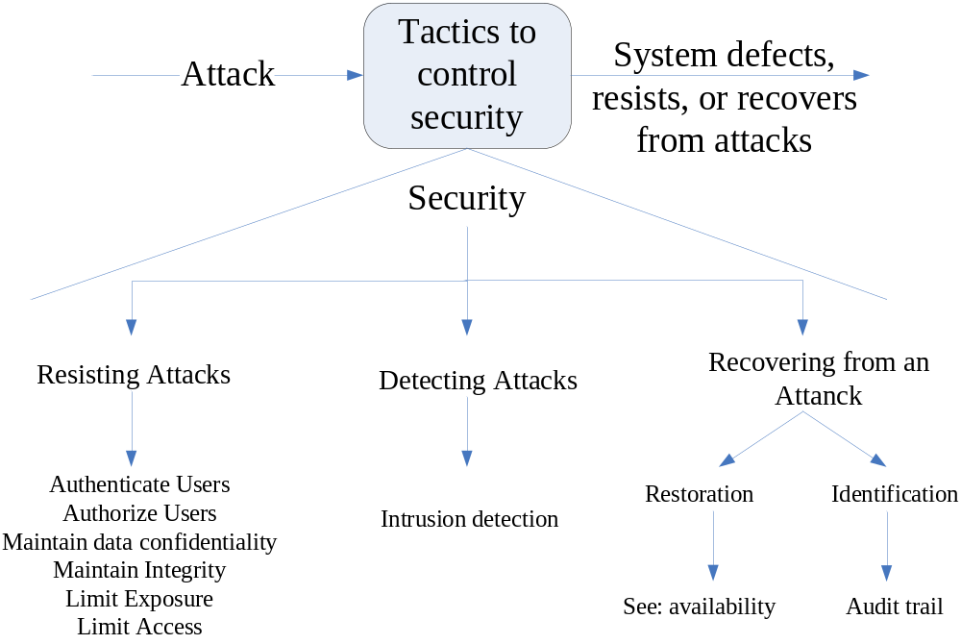
Security Tactics

Slide 81
Security Tactics (2)
Resisting Attack
  Authenticate users.
    Ensuring that a user or remote computer is actually who it purports to be.
    Passwords, digital certificates, etc, provide authentication.
    New component
    Modify connector

Slide 82
Security Tactics (2)
Resisting Attack
  Authorize users
    Ensuring that an authenticated user has the rights to access and modify either data or services.
    Providing some access control patterns within a system
    New component
    Modify connector

Slide 83
Security Tactics (2)
Resisting Attack
  Maintain data confidentiality
    Data should be protected from unauthorized access
    Applying some form of encryption to data and to communication links
    Modify connector/ component

Slide 84
Security Tactics (3)
Resisting Attack
  Maintain integrity
    Modify component/ port
    New connector
      Trigger, constraint…
  Limit access
    Firewalls restrict access based on message source or destination port
    Modify connector

Slide 85
Security Tactics (3)
Resisting Attack
  Limit exposure
    Attacks typically depend on exploiting a single weakness to attack all data and services on a host
    Design the allocation of services to hosts so that limited services are available on each host
    More component
    Modify component port
    New connector: data replicated and sliced
    Modify connector: distributed or clustered

Slide 86
Security Tactics (4)
Detecting Attacks
  Usually through an intrusion detection system
  Such systems work by comparing network traffic patterns to a database.
    The traffic pattern is compared to historic patterns of known attacks
  Frequently, the packets must be filtered
    Filtering can be on the basis of protocol, TCP flags, payload sizes, source or destination address, or port number
  New component( modify Connector) : detecting filter

Slide 87
Security Tactics (5)
Recovering from attacks
  Divided into:
    Those concerned with restoring state
    Those concerned with attacker identification
  Restoring the system or data to a correct state overlap with those used for availability
    since they are both concerned with recovering a consistent state from an inconsistent state
    See availability

Slide 88
Security Tactics (5)
Recovering from attacks
  Identifying an attacker is to maintain an audit trail.
    An audit trail is a copy of each transaction applied to the data in the system together with identifying information.
    Audit information can be used to trace the actions of an attacker and support system recovery.
    Modify connector (new component): audit

Slide 89
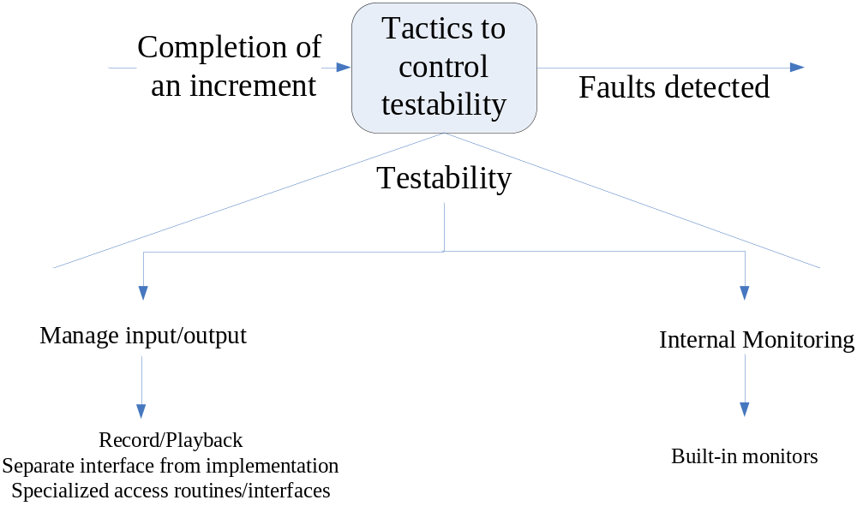
Testability Tactics

Slide 90
Testability Tactics (2)
Manage input/output
  Record/playback.
    Record/playback refers to both capturing information crossing an interface and using it as input into the test harness
    Modify connector : with record
    New component: play back
  Separate interface from implementation
    Separating the interface from the implementation allows substitution of implementations for various testing purposes.
    New component: test bus
    Modify connector: ..→dynamic ..

Slide 91
Testability Tactics (2)
Manage input/output
  Specialize access routes/interfaces
    Having specialized testing interfaces allows the capturing or specification of variable values for a component through a test harness as well as independently from its normal execution
    Modify component port
    Modify connector: Specialize access routes

Slide 92
Testability Tactics (3)
Internal monitoring
  Built-in monitors
    The component can maintain state, performance load, capacity, security, or other information accessible through an interface.
    Can be introduced temporarily via an instrumentation technique such as aspect-oriented programming
    A common technique is to record events when monitoring states have been activated
    New component
    Modify component port / new connector

Slide 93
The End

